Slide 1
Bellwork Monday 8/17/15
Agenda:
Bellwork
Vocab
Marking the Text
Homework:
Parent letter signed – due 8/18
Imagine that you win a contest to meet a celebrity. Write a story about whom you would meet and what would happen.
Must be at least 5 sentences, characters (you & singer)have a beginning, middle, and end.
EXAMPLE: Yesterday, I won tickets to meet Ariana Grande at her concert. When I got there I was escorted to her dressing room to meet her. She was as pretty and kind as I thought she was. I was then escorted to my front row seat to enjoy her concert. During her performance she called me up to the stage to sing and dance with her. This was the best night of my life.

Slide 2
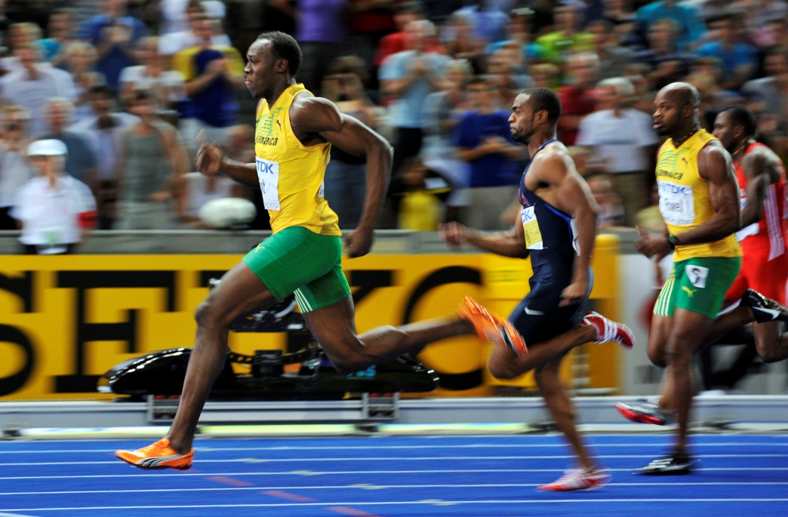
Agenda 8/18
Bellwork
Collect HW
Marking the Text
Bats
Use the photo to help you write 3 good sentences using the conjunctions “and”, “but” and “or”. Use ONE in each sentence.

Slide 3
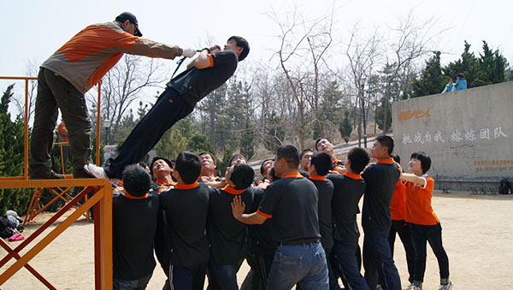
Agenda 8/19
Bellwork
Return to Bats
Grammar- Use the photo to help you write 3 good sentences using the conjunctions “and”, “but” and “or”. Use ONE in each sentence.

Slide 4
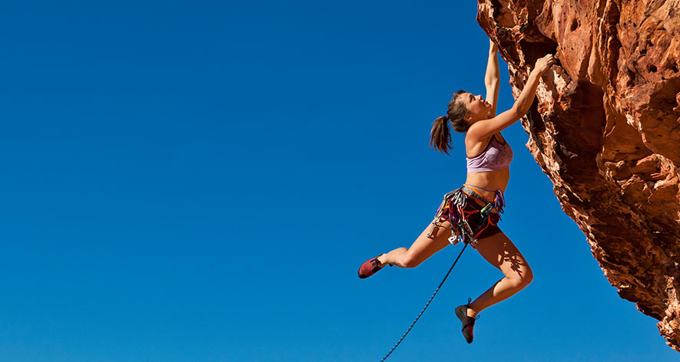
Agenda 8/20:
Bellwork
Mark the Text - Bats
Vocab Assignment
Free write
Use what you see, hear, smell, feel to write 4 or MORE good sentences describing the photo. Be prepared to share with a partner or the class.

Slide 5
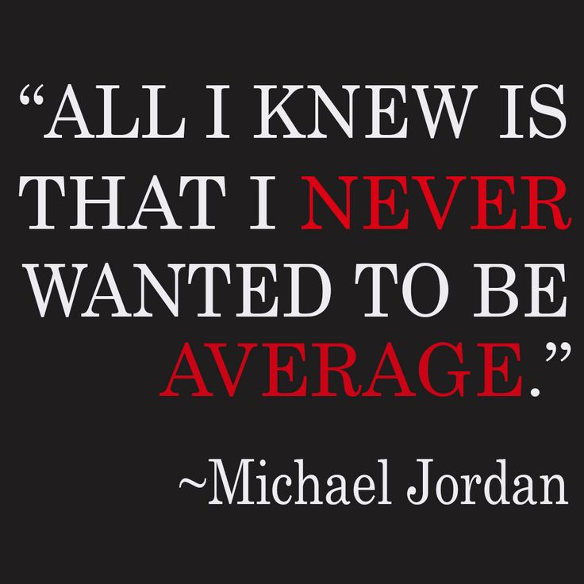
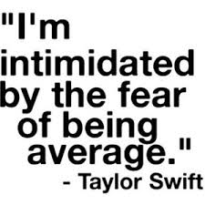
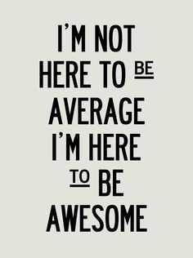
Friday – August 21
What will you do to make sure you’re not average?
Write a 5 – 10 sentence paragraph describing ways to go above and beyond “AVERAGE”

Slide 6
BATS – T-CHART
Claim:
Why? Support
- Use examples from the text

